Slide 1
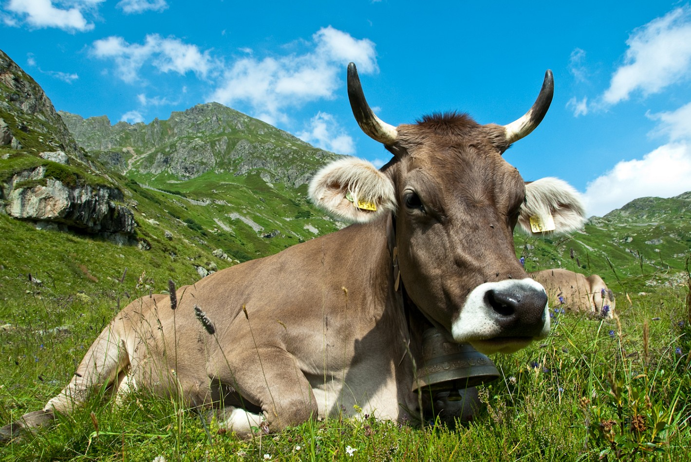
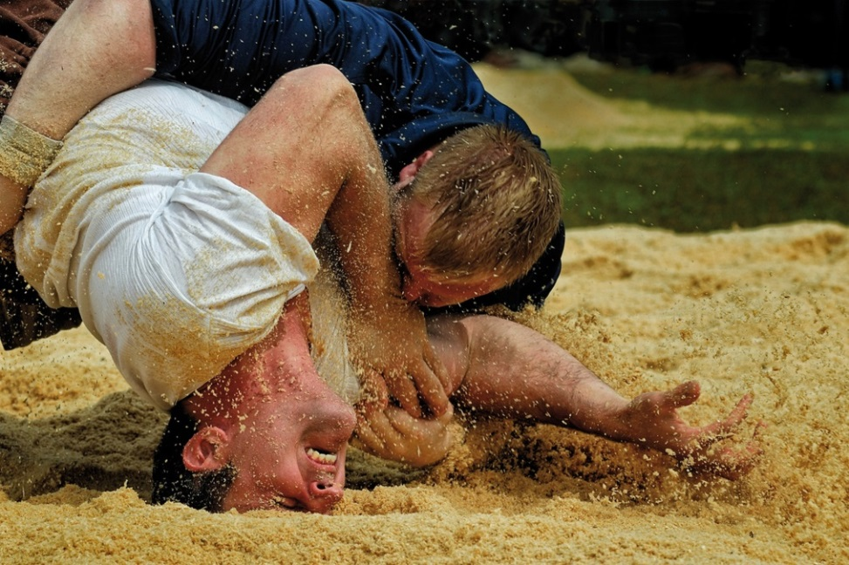

Slide 2
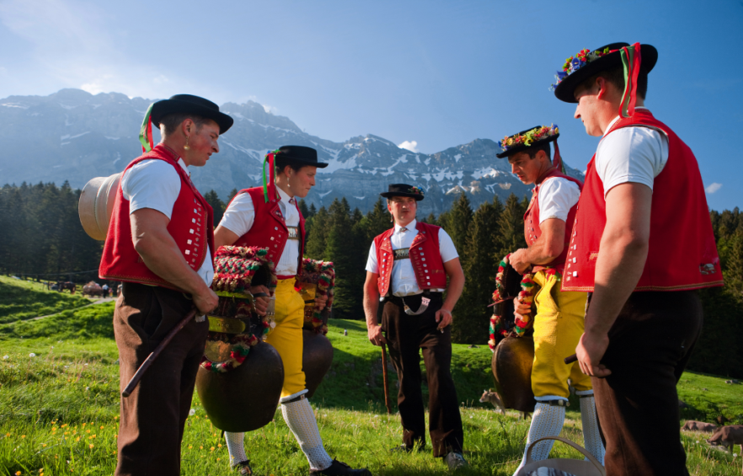

Slide 3
Member of
&

Slide 4
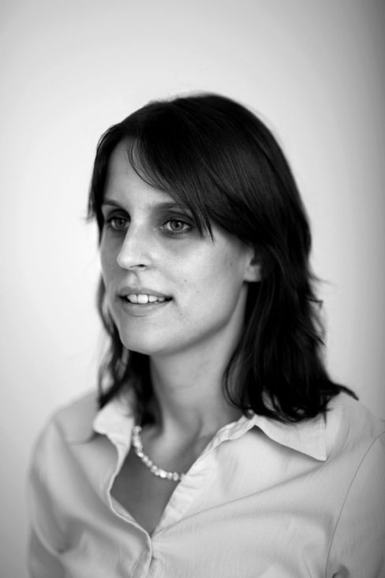
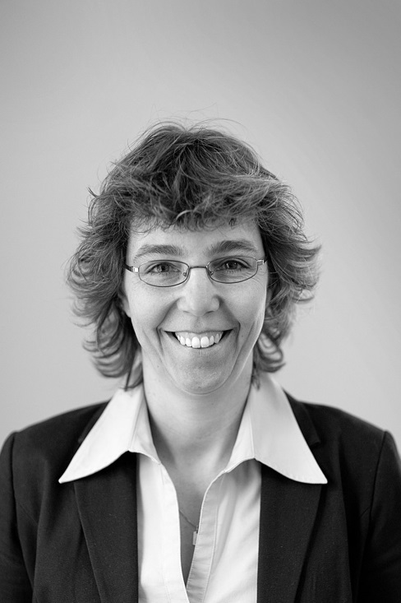
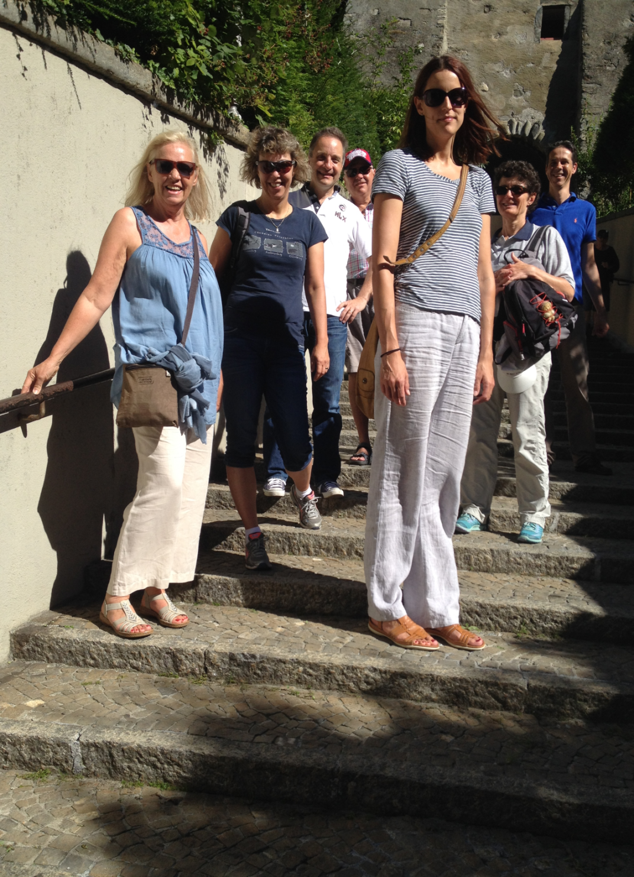
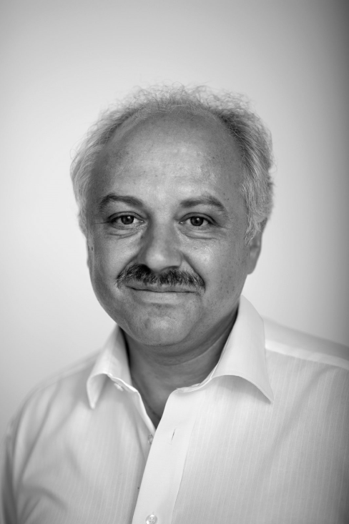
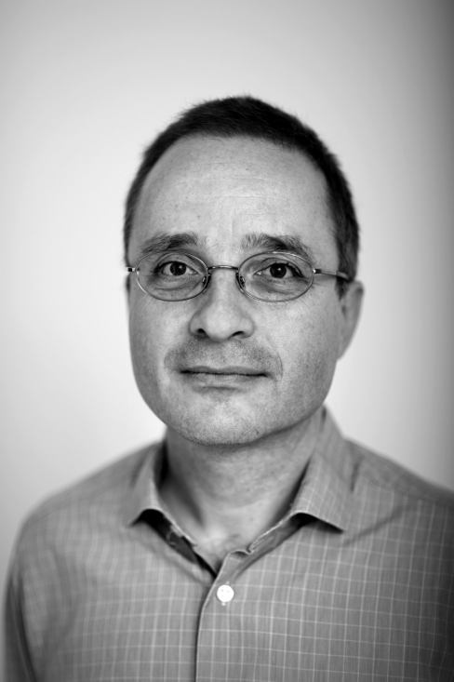
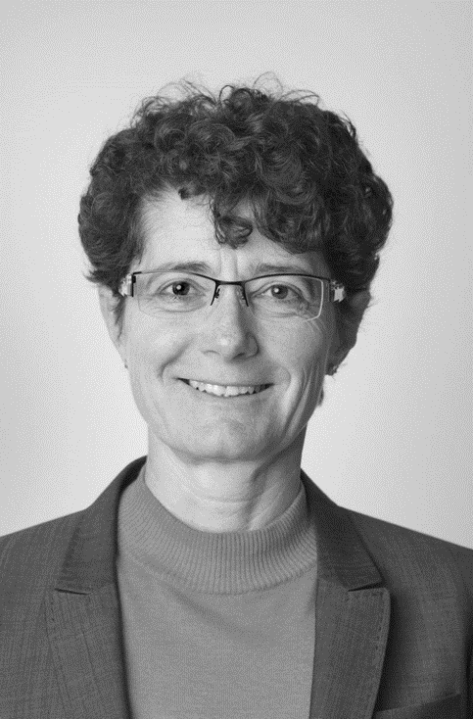
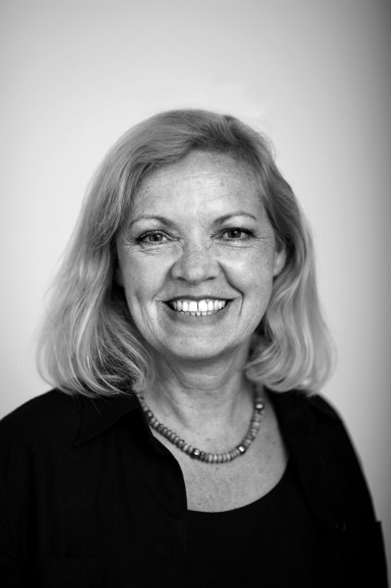
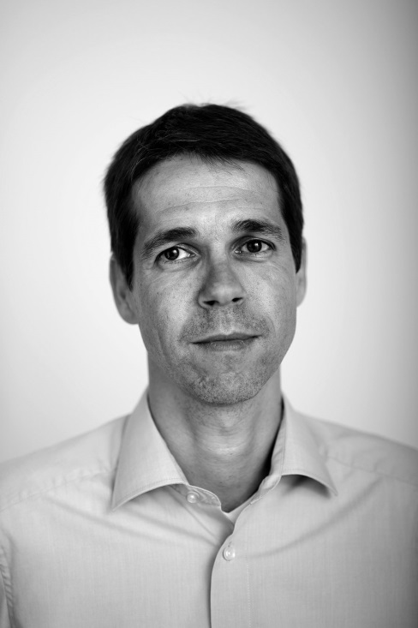
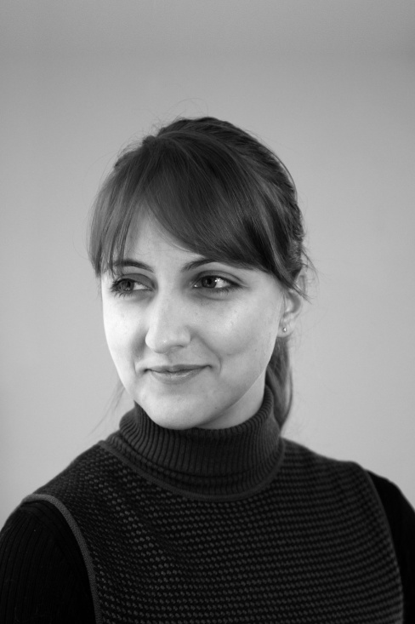

Slide 5
Our Mission Statement
Corporation
Corpus – being a body,
a community dedicated to each other.
Company
Companio – having a companion, one who eats bread [pane] with you.
Consilium
Council, advisory board for our clients.

Slide 6
External Challenges

Slide 7
External Challenges

Slide 8
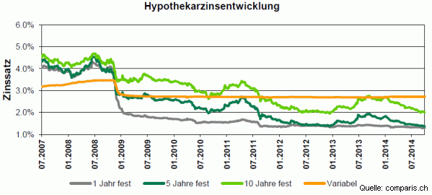
External Challenges

Slide 9
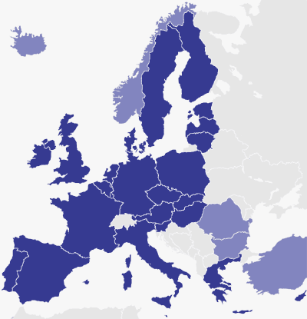
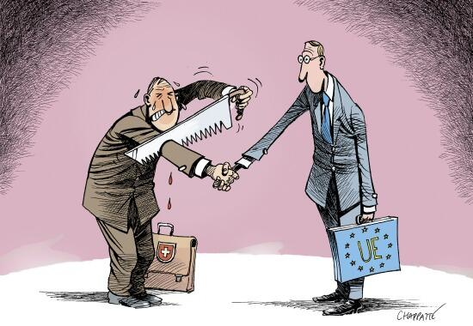
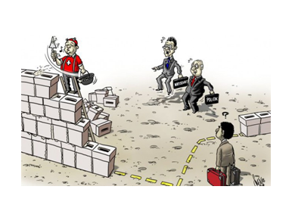
External Challenges

Slide 10
Internal Challenges

Slide 11
Internal Challenges

Slide 12
What we do

Slide 13
Recent & Current Projects

Slide 14
Recent & Current Projects

Slide 15
Recent & Current Projects

Slide 16
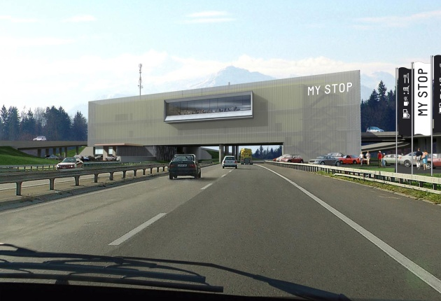
Recent & Current Projects

Slide 17
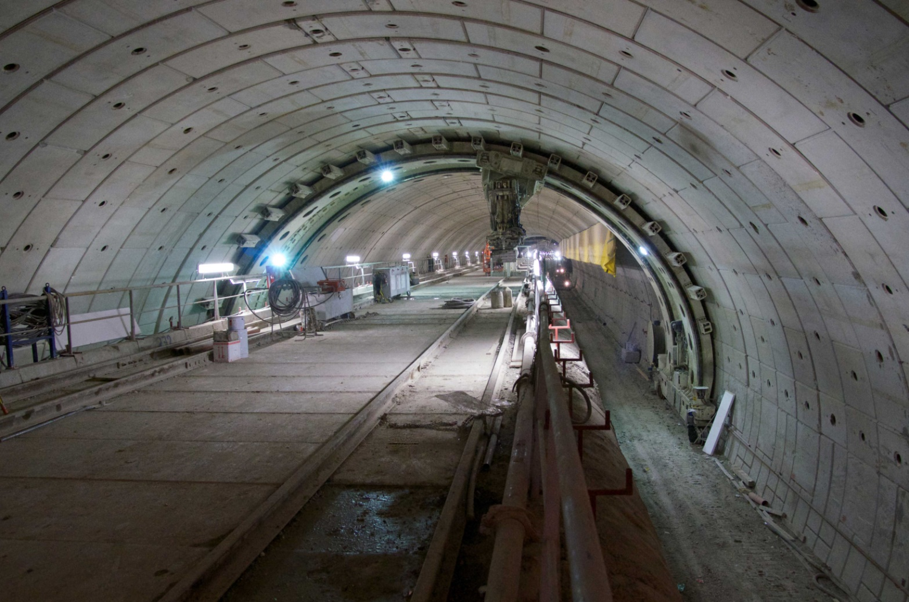
Recent & Current Projects

Slide 18
Thank you

